Slide 1
if Statements &&
boolean Primitive type
Mr. Neat
Java

Slide 2
What if you only wanted
some of your code to run?
We need to be able to select
blocks of code to run
conditionally

Slide 3
Require 2 ingredients
boolean primitive type
if statement structure

Slide 4
boolean Primitive type
Review primitives
int tom;
double henry;

Slide 5
boolean Primitive type
A third (and final) primitive type:
boolean jack;
boolean
boolean variables are either equal to true or false

Slide 6
boolean Primitive type
Review
int primitive types can be compared using comparison operators:
> less than
< greater than
= = equal to (note, 2 equal signs)

Slide 7
boolean Primitive type
Review ints
5 < 7
boolean
expression

Slide 8
boolean Primitive type
combine ideas:
boolean jane;
jane = (4 == 5);
System.out.println(jane);

Slide 9
Require 2 ingredients
boolean primitive type
if statement structure

Slide 10
if Statements - Syntax
if(boolean)
{
// statements execute only
// if boolean is true
}
// statement execute always

Slide 11
if Statements - Syntax
int z = 16;
int y = 5;
boolean x = 5 > 16;
if(x)
{
System.out.println(z);
}

Slide 12
if Statements - Syntax
if(5 > 16)
{
System.out.println(z);
}
or equivalently...

Slide 13
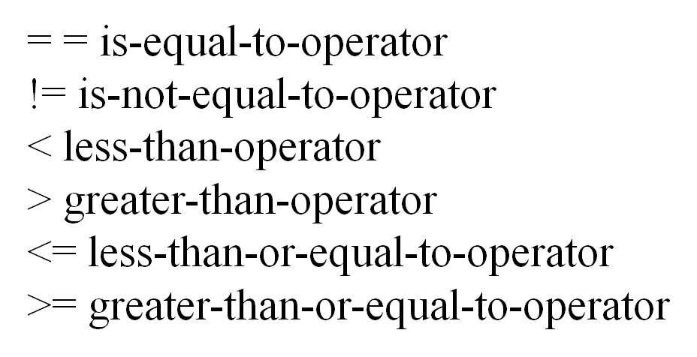
boolean expressions
if(5 > 16)
{
System.out.println(z);
}

Slide 14
If Statements - Lab
Write a program that has 2 int variables
Initialize these variables some int value (your choice)
Write a message out to the screen if the two values are different
Verify your code works by trying different int values

